Slide 1

AASD 4016
Full Stack Data Science Systems
Applied AI Solutions Developer Program

Slide 2
Module 3
Clients
Vejey Gandyer

Slide 3
Agenda
Clients
Curl
POSTMAN
Python Web Client
Templates
Receive Arguments
Examples

Slide 4
Clients
Curl
POSTMAN
Python

Slide 5
Flask
Installing Flask
pip install Flask
Hello Flask Application (hello.py)
from flask import Flask
app = Flask(__name__)
@app.route("/")
def hello_world():
return "<p>Hello, World!</p>"

Slide 6
Flask
Running a Flask Application
export FLASK_APP=hello
flask run
Set Flask Environment
export FLASK_ENV=development

Slide 7
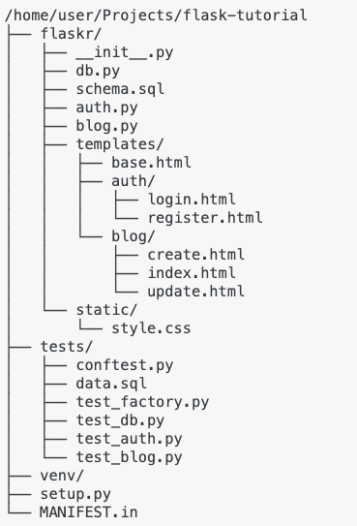
Project Structure

Slide 8
Current Flask project structure
Project Structure
app.py
helper(s).py [Optional]

Slide 9
Iris Classifier
Notebook to Script
Script to Flask
Load model and keep it up for inference
Infer from the model
Test the endpoint using Curl, POSTMAN
Build a python web client
Test the client

Slide 10
Expected Flask project structure
Project Structure
app.py
helper(s).py [Optional]
templates/
index.html
result.html
static/
Style.css [Optional]

Slide 11
Curl
curl http://localhost:5000/
curl http://localhost:5000/classify

Slide 12
Future Curl Calls (to be developed)
curl http://localhost:5000/
curl http://localhost:5000/classify?sl=5.1&sw=3.2&pl=3.5&pw=4.2

Slide 13
POSTMAN
www.postman.com
Download and install the application
Follow along the demo

Slide 14
POSTMAN
Create a Collection
Create endpoint (either GET / POST)
Give the URL for the endpoint
Give the parameters for the endpoint (if any)
Get the response

Slide 15
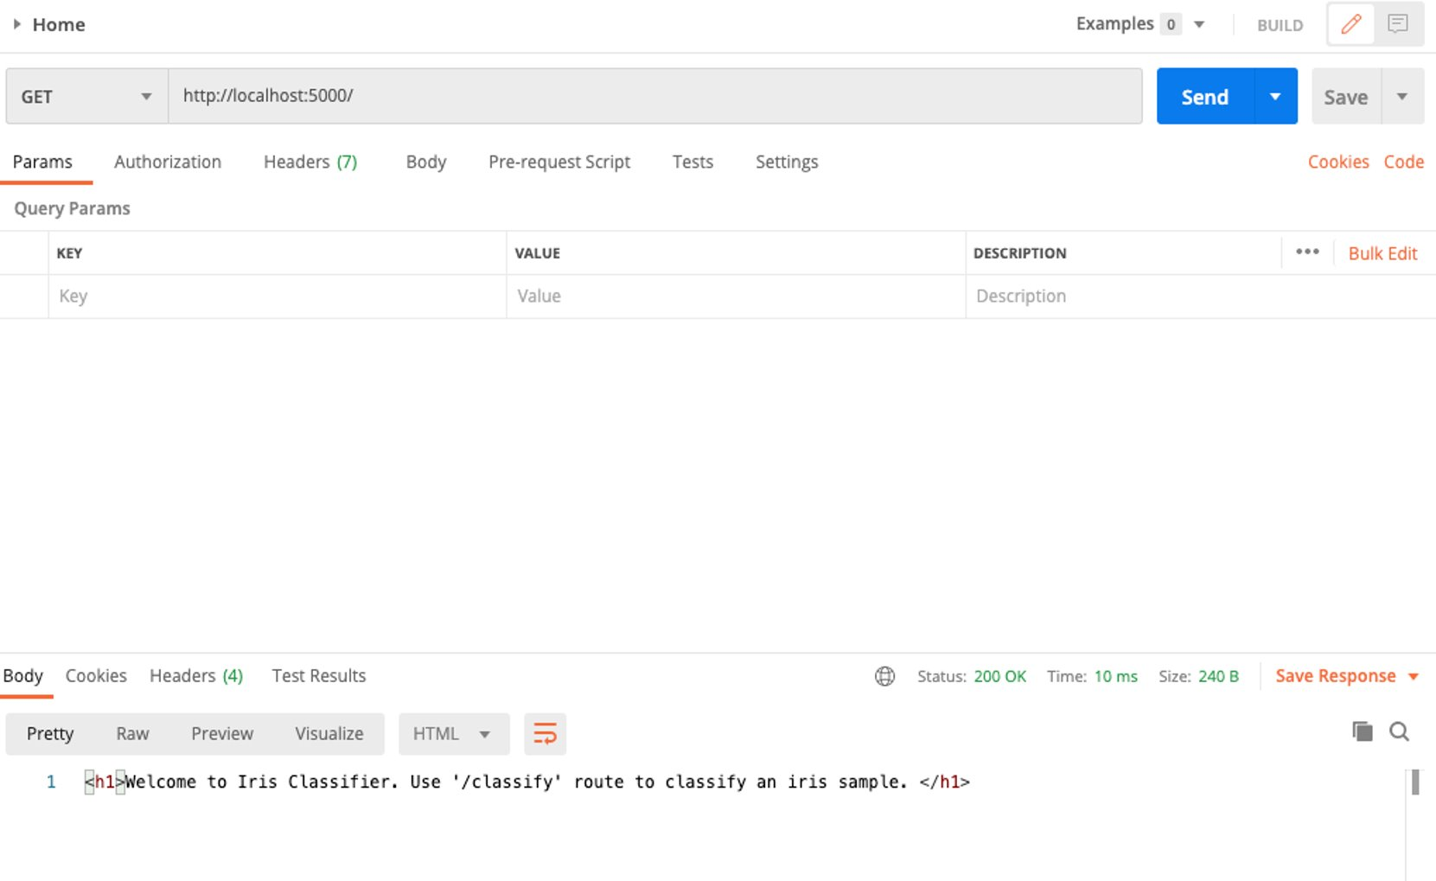

Slide 16
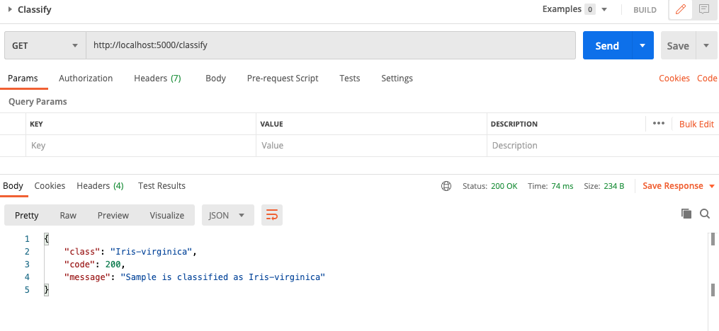

Slide 17
Python Web Client
Create Web client with html
Include the input fields within html
Stylize the html elements with css (Optional)
Connect the button with corresponding Flask function

Slide 18
HTTP Request Methods
GET
POST
PUT
HEAD
DELETE

Slide 19
GET
GET is used to request data from a resource
Query String is sent in the URL of a GET request
Developer Tools
/test_endpoint?name=subash&age=41

Slide 20
POST
POST is used to send data to a server to create / update a resource
Data sent to the server is stored in the request body of the HTTP request
Developer Tools
POST /test_endpoint HTTP/1.1 Host: iamsubash.com name=subash&age=41

Slide 21
PUT
PUT is used to send data to a server to create / update a resource
Calling PUT request multiple times produce the same result
Calling POST request multiple times produce multiple resources

Slide 22
HEAD
HEAD is identical to GET, but without the response body
HEAD requests are useful for checking what a GET request will return before actually making an actual GET request
Before downloading a very large file

Slide 23
DELETE
DELETE deletes the specified resource

Slide 24
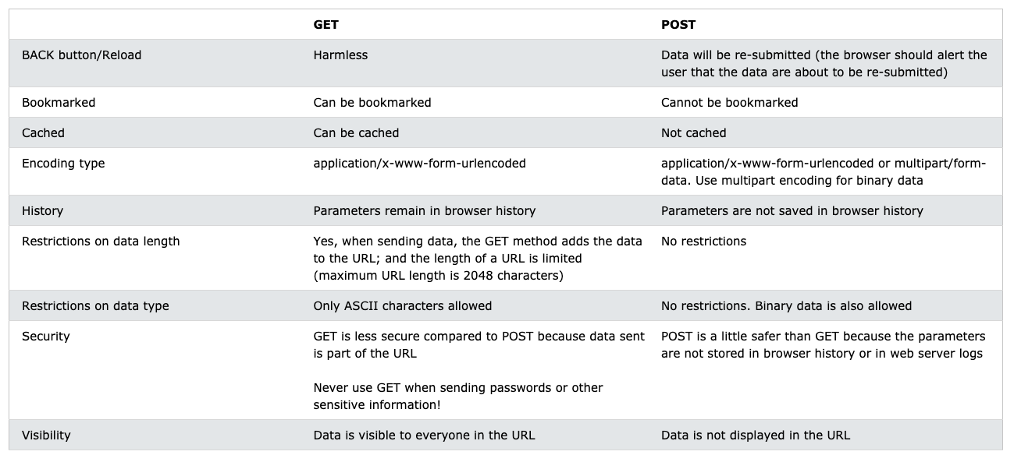
GET vs POST

Slide 25
Flask HTTP Methods
HTTP Methods
from flask import request @app.route('/login', methods=['GET', 'POST']) def login(): if request.method == 'POST': return do_the_login() else: return show_the_login_form()

Slide 26
Receive Arguments
from flask import request @app.route('/classifier', methods=['GET', 'POST'])
def classifier():
sepalLength = float(request.args['sepalLength'])
sepalWidth = float(request.args['sepalWidth'])
petalLength = float(request.args['petalLength'])
petalWidth = float(request.args['petalWidth'])

Slide 27
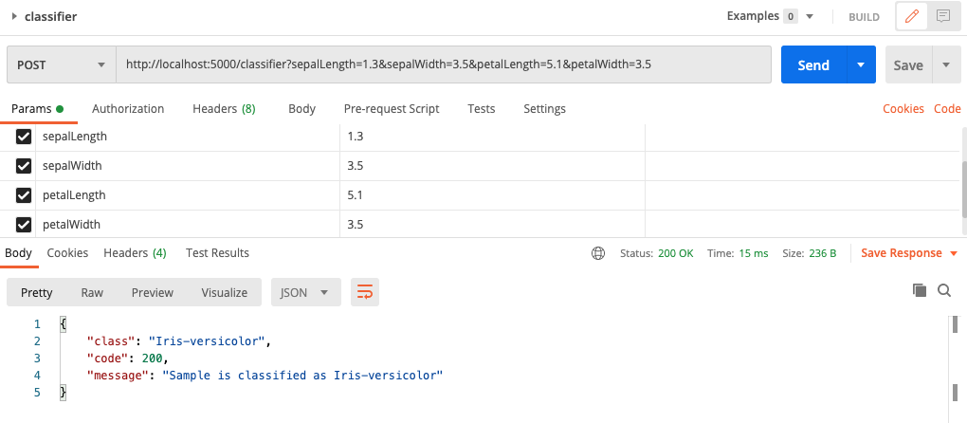
Receive Arguments

Slide 28
Index.html
<html>
<body>
<h1>IRIS Classifier</h1>
</body>
</html>

Slide 29
Result.html
<html>
<body>
<h1>IRIS Classifier</h1>
{{ result }}
</body>
</html>

Slide 30
Rendering Templates
from flask import render_template @app.route('/hello) def hello(name=None): return render_template('index.html', name=name)
@app.route('/classifier, methods=['GET', 'POST'])
def classifier():
…
…
return render_template('result.html', result=result)

Slide 31
Receive Arguments: Checkbox
<form action="/classifier" method="post" enctype="multipart/form-data">
<h4> Choose a choice </h4>
<label>Yes</label><input type="checkbox" name="yes" default=False />
<label>No</label><input type="checkbox" name="no" default=False />
@app.route('/classifier, methods=['GET', 'POST']) def classifier(): if request.method == 'POST': yes_choice = request.form.get('yes') ...

Slide 32
Receive Arguments: Radio Button
<form action="/classifier" method="post" enctype="multipart/form-data">
<h4> Choose a Gender </h4> <span style="color:red;"> *</span>
<label>Gender</label> <span style="color:red;"> *</span>
<label>MALE</label><input type="radio" name="gender" id="male" value="MALE">
<label>FEMALE</label><input type="radio" name="gender" id="female" value="FEMALE">
@app.route('/classifier, methods=['GET', 'POST'])
def classifier():
if request.method == 'POST': gender = request.form.get('gender') ...

Slide 33
Receive Arguments: File uploads
<form action="/classifier" method="post" enctype="multipart/form-data">
<h4> Choose a CSV file </h4> <span style="color:red;"> *</span>
<input type="file" name="csv" />
@app.route('/classifier, methods=['GET', 'POST']) def classifier(): if request.method == 'POST': f = request.files['csv'] f.save('/var/www/uploads/uploaded_file.txt') ...

Slide 34
Receive Arguments: Secure File uploads
from werkzeug.utils import secure_filename @app.route('/classifier, methods=['GET', 'POST']) def classifier(): if request.method == 'POST': f = request.files['the_file'] f.save(f'/var/www/uploads/{secure_filename(f.filename)}') ...

Slide 35
style.css [Optional]

Slide 36
All together for a Python Web Client
index.html
app.py
style.css [ Optional ]

Slide 37
Testing Python Web Client
Test all endpoints
- Curl
- Postman

Slide 38
Further Reading
Flask Tutorial
https://flask.palletsprojects.com/en/2.0.x/tutorial/

